Slide 1

Social Media Analysis
Fathima Arshi

Slide 2
CONTENTS
1
2
3
4
5
About META
Data Overview
Problem statement
& Approach
Analysis,
Campaigns and Projections
Conclusion

Slide 3

About META
Meta is a global technology leader focused on building innovative platforms that enable people to connect, communicate, and create digital communities. Its ecosystem—including Facebook, Instagram, WhatsApp, and Reality Labs—empowers billions of users worldwide. Instagram, one of Meta’s fastest-growing platforms, plays a crucial role in visual storytelling and community engagement. With millions of daily interactions, Instagram provides valuable insights into user behavior that can drive meaningful marketing strategies and business growth.

Slide 4
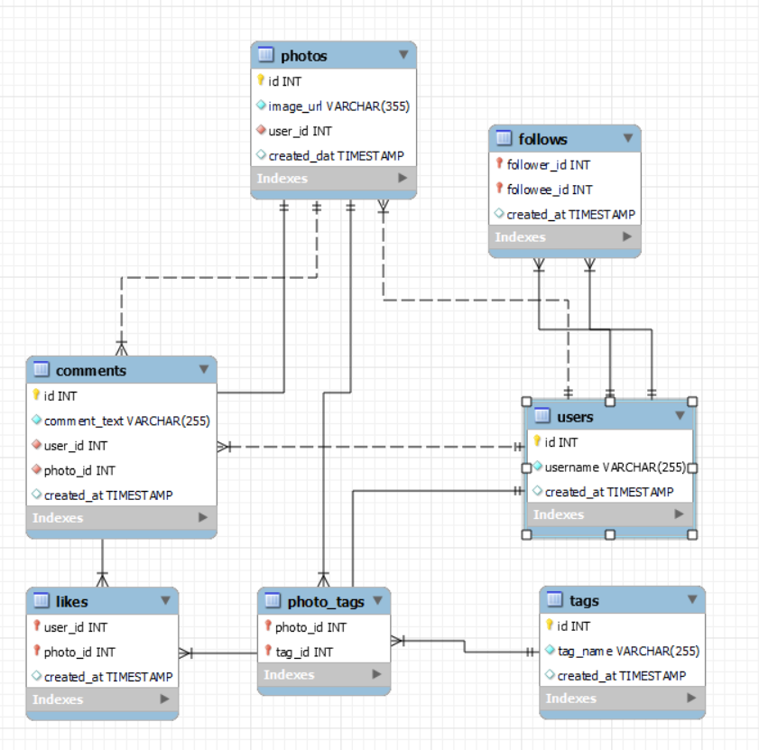
Data overview
1. Total 7 Tables are present in the given dataset.
2. Total number users are 100.
3. Total number of posts made so far is 257.
4. Total number of likes posted by the users on posts is 8782.
5. Total number of comments on all posts are 7488.
6. Total number of engagement is calculated by adding total likes and total comments by an user.
7. Engagement rate is calculated by dividing total engagements by number of posts.

Slide 5
Problem
Statement
You are hired as a data analyst at Meta and asked to collaborate with the Marketing team. Marketing teams want to leverage Instagram's user data to develop targeted marketing strategies that will increase user engagement, retention, and acquisition. Provide insights and recommendations to address the following objectives.

Slide 6
Approach
1. Data Understanding : Reviewed the dataset structure, identified the 7 core tables, and analyzed how entities such as users, posts, likes, comments, tags, and follows are interconnected.
2. Data Loading & Inspection : Imported the dataset and performed initial checks for missing values, duplicates, and data types.
3. Data Cleaning : Handled inconsistencies, ensured relational integrity, and validated keys across tables (user_id, photo_id, tag_id, etc.).
4. Exploratory Data Analysis (EDA) : Calculated total users, posts, likes, comments, and engagement metrics to understand platform behavior.
5. Feature Engineering : Derived new metrics such as total engagements, engagement rate, top hashtags, and user-based activity metrics.

Slide 7
6. Query Writing & Optimization
Used SQL CTEs, joins, aggregations, window functions, and subqueries to extract insights like:
  Highest engagement hashtags
  Reciprocal follow relationships
  Most liked posts
  Active vs. passive users
7. Insight Generation
Interpreted the results with a focus on user behavior, content performance, and engagement patterns.
8. Visualization & Reporting
Prepared charts, summaries, and structured sections (overview, approach, insights, etc.) for presentation.

Slide 8
Engagement Analysis
Top users record 149–166 engagements, far above the platform average.
Overall average engagement rate is 65 across all users.
Only 31 users exceed the average, and 18 users cross 100 engagements.
We will analyze and promote content types from these high-engagement users to increase overall platform activity.

Slide 9
Content Performance
Dreamy Tag has the highest likes where as foodie tags has lowest number of likes.
Hashtags with high count of Likes are the popular tags among all.
Popular tags will be promoted and influencers will promote popular tags by using them in their posts.
Contents related to these tags should be frequently shown on explore pages of the users to engage them.
Tags other than dreamy have very much same no. of likes so they should also be optimized.

Slide 10
Advertisement Strategy
Ad campaigns on the basis of user’s category.
Utilize user data for personalized ad and content.
Notifications and recommendations should be given on the basis of content users follow and like the most.
Collaborations with the Highly engaged users to encourage others for re-engaging on the platform.

Slide 11
User Classification
Highly Engaged Users: 30 users show consistently high activity and strong interaction levels.
Moderately Engaged Users: 34 users maintain a balanced but lower engagement compared to the top group.
Less Engaged Users: 10 users show minimal activity and require targeted strategies to improve participation.

Slide 12
Old Users (65%) – Majority of the users joined before 2017, showing a strong base of long-term users.
New Users (35%) – The remaining users joined after 2017, indicating gradual platform growth over the years.
These classification is so that personalized ads and campaigns can be made for different class to improve engagement rates and make interface user friendly.

Slide 13
Campaigns and Projections
Targeted campaigns should be planned based on user categories and the type of content they frequently browse, ensuring higher relevance and response rates.
Personalized notifications and emails must be sent to users to boost engagement, using messages that are catchy, friendly, and non-intrusive to avoid irritation.
Underperforming ad campaigns should be continuously monitored, analyzed, and replaced with improved, trend-aligned alternatives.
Brand collaborations and creator partnerships should be expanded, offering paid promotions to users who consistently show high reach and strong engagement performance.

Slide 14
CONCLUSION
The analysis reveals three key user categories—Highly Engaged, Moderately Engaged, and Less Engaged—with a need for greater focus on the Less Engaged segment to improve overall platform activity. Hashtags continue to play a crucial role in boosting engagement, making it essential to monitor and utilize trending topics effectively. With reels emerging as the most engaging content format, especially among new users, creators and influencers should be encouraged to produce reel-based content aligned with popular hashtags. Additionally, regular trend-optimized ad campaigns, combined with notification-based promotions through in-app alerts and emails, will help enhance visibility, engagement, and user retention across the platform.

Slide 15
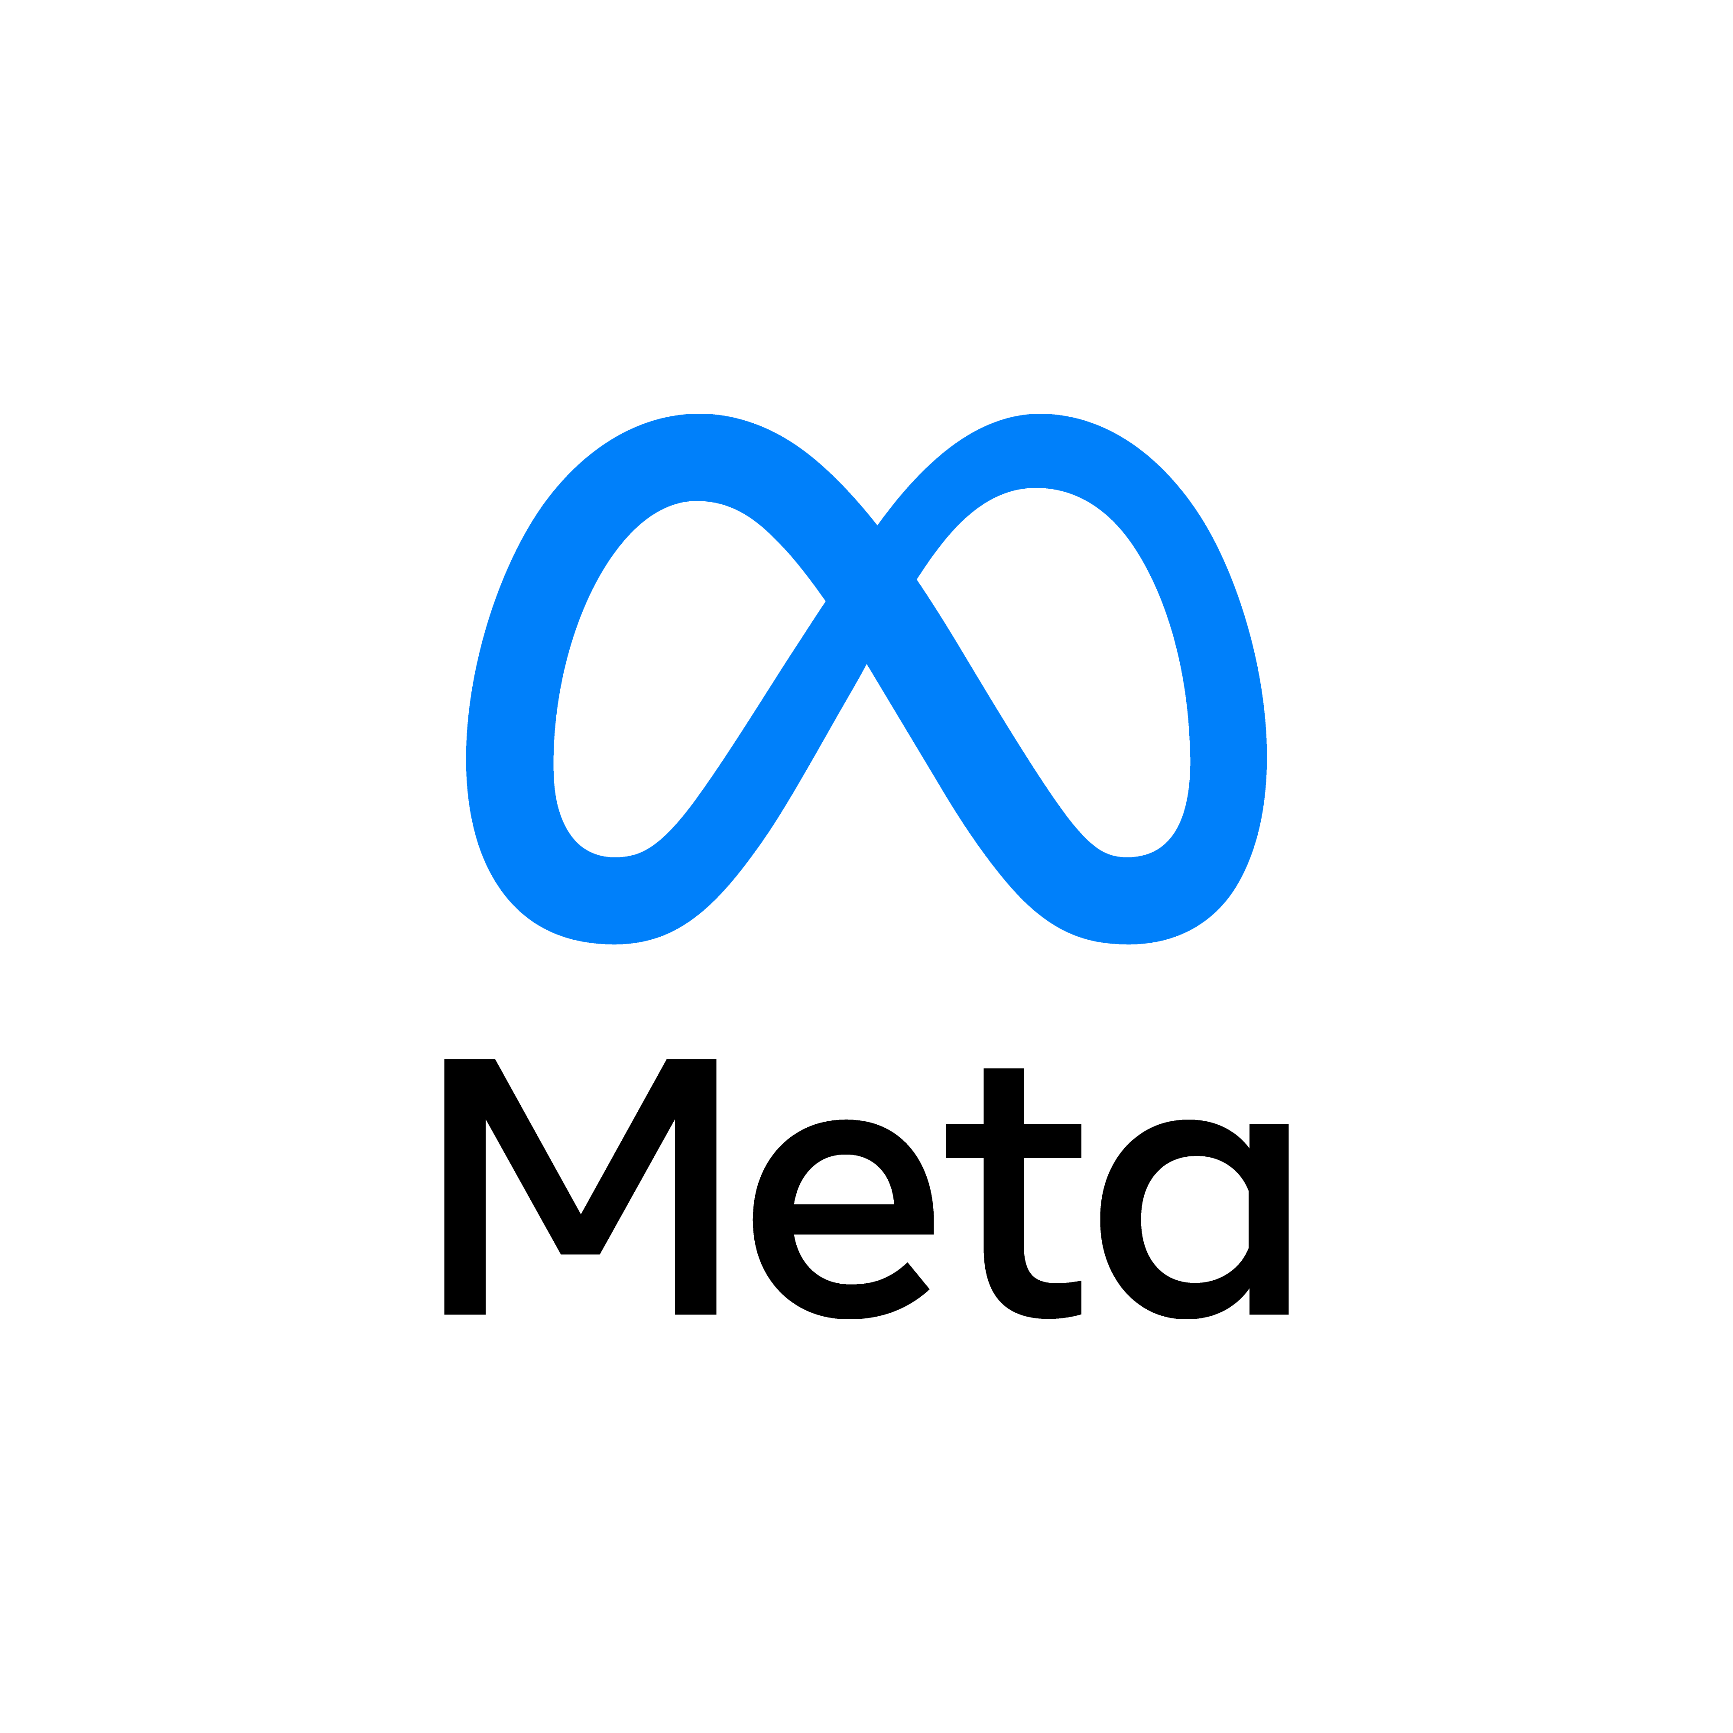
THANK YOU

